Slide 1
Circuits and Code: FUN with Arduino!
Natalia Baklitskaya
Natalia.Baklitskaya@gmail.com

Slide 2
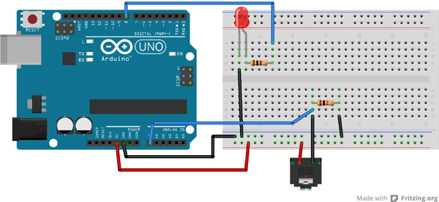
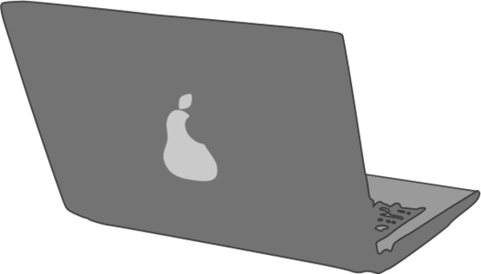
What is Arduino?
The heart (or the brain) of DIY projects
Microcontroller
A board with a chip that can be programmed to do many different things
Inputs (digital and analog)
Read input from sensors like ultrasonic sensor and thermistor
Outputs
Drive Circuitry

Slide 3
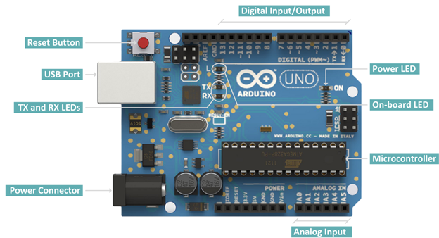
What is Arduino?
The heart (or the brain) of DIY projects

Slide 4
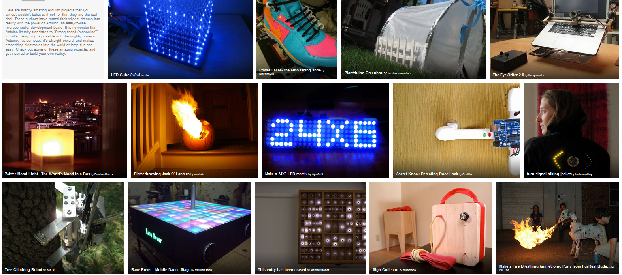
What Can I Build With Arduino?
http://www.instructables.com/id/20-Unbelievable-Arduino-Projects/

Slide 5
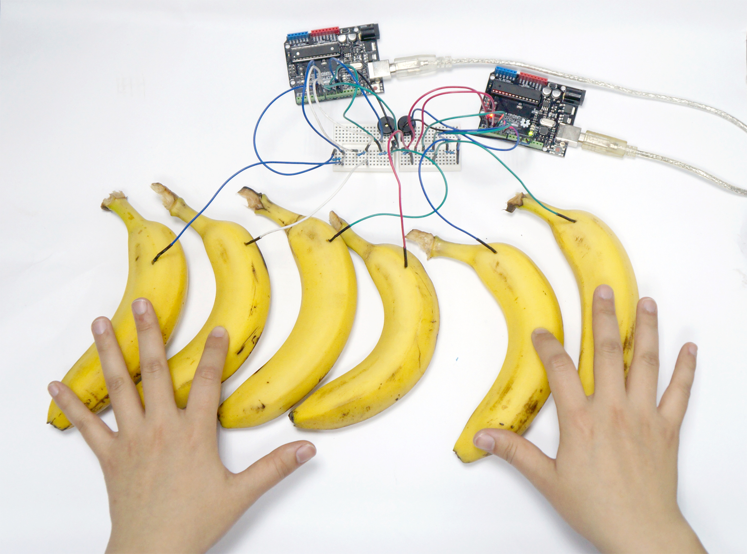
What Can I Build With Arduino?

Slide 6
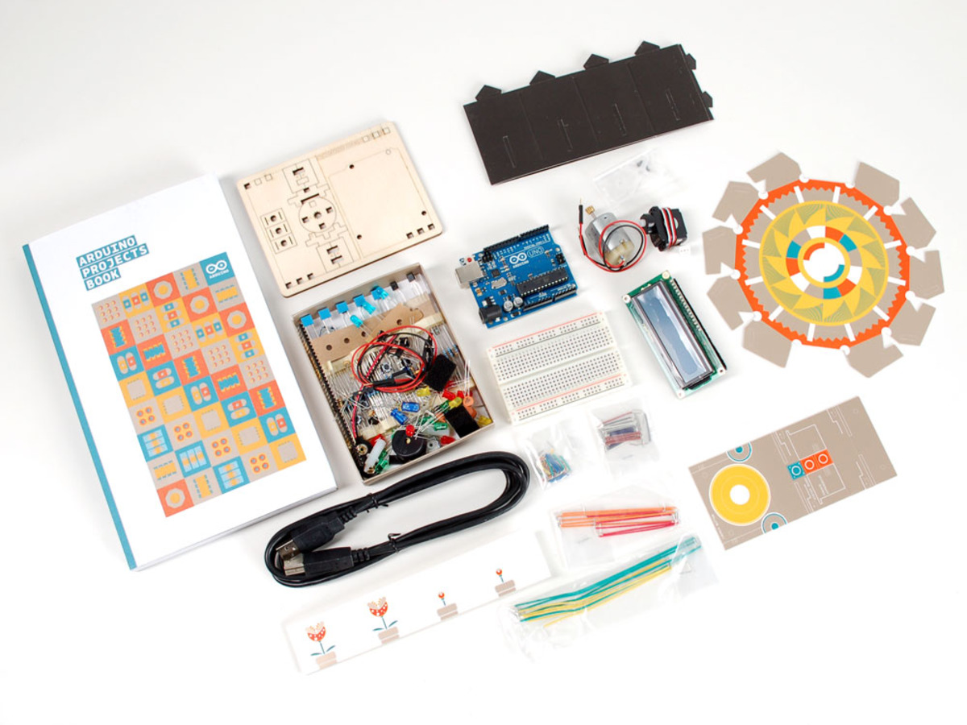
What are you working with?

Slide 7
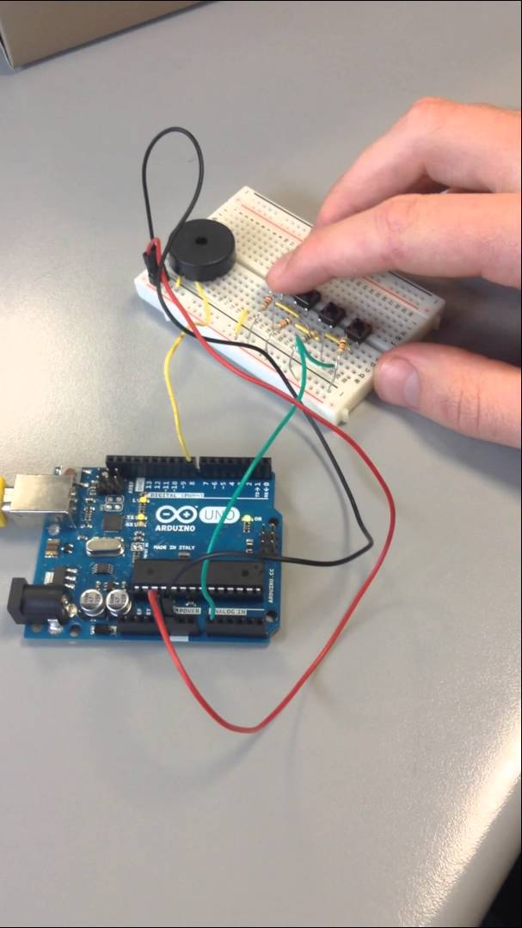
What Can I Build With Arduino?
Spaceship Interface
Love-O-Meter
Color Mixing Lamp
Mood Cue
Light Theremin
Keyboard Instrument
Digital Hourglass
Motorized Pinwheel
Zoetrope
Crystal Ball
Knock Lock
Touchy-feely Lamp

Slide 8
Who are you working with?
Groups
Teaching Assistants!

Slide 9
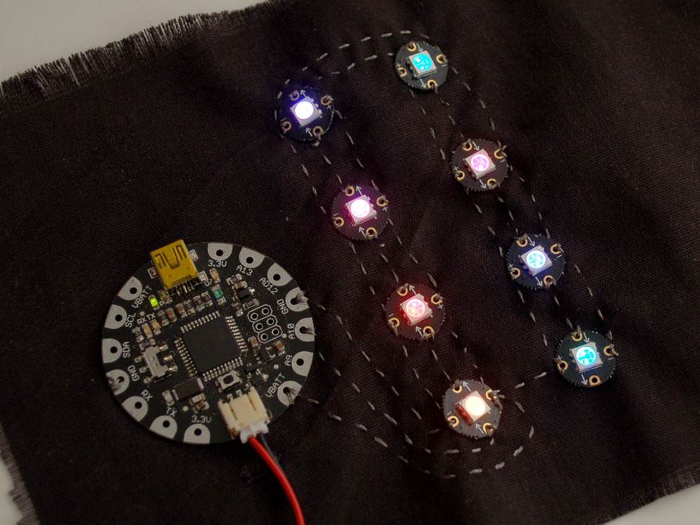
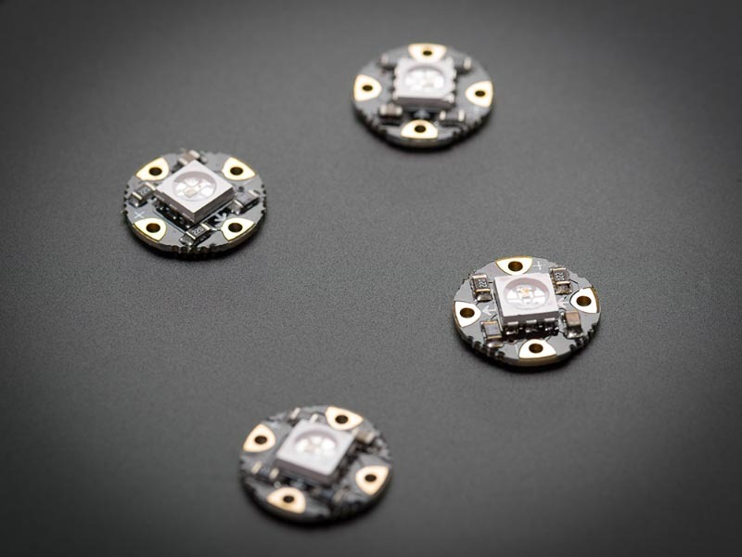
NeoPixels for Makers!

Slide 10
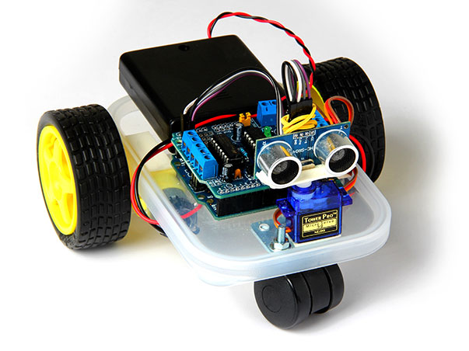
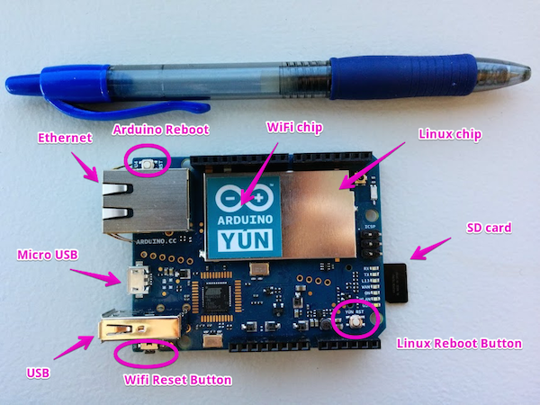
But what about Robots and IoT?
“..Once you’ve finished this tutorial, you may want to put your newly acquired skills to use by:
Building an Arduino Yun powered photo booth
Sending SMS and MMS from your Arduino Yun
Teaching your dog to send you selfies with the Arduino Yun “

Slide 11
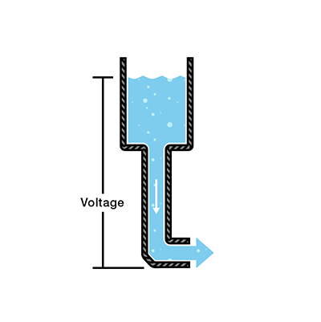
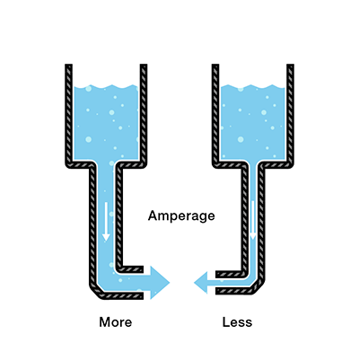
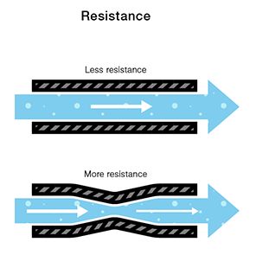
Voltage, Current, Resistance
Voltage is the difference in charge between two points.
Current is the rate at which charge is flowing.
Resistance is a material’s tendency to resist the flow of charge (current).
V = I * R

Slide 12
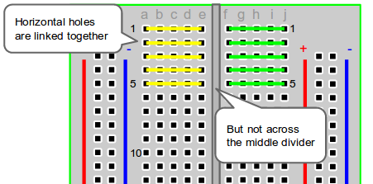
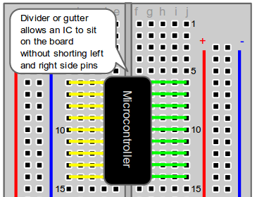
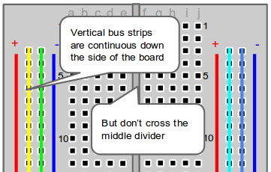
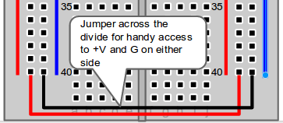
Breadboard Pins
http://computers.tutsplus.com/

Slide 13
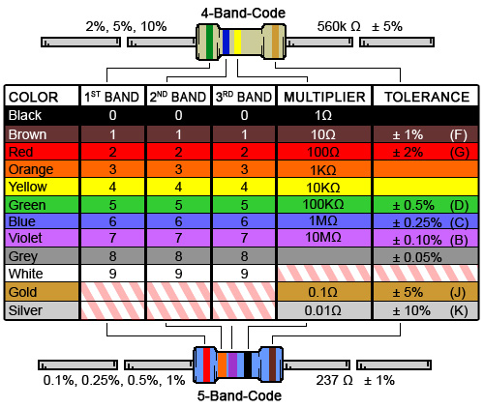
Resistor Color Codes

Slide 14
Digital Logic Levels + Analog Pins
OFF = 0 = 0 Volts
ON = 1 = 5 Volts
Analog pins have 1024 levels between 0 Volts and 5 Volts

Slide 15
Arduino Code: setup() and loop() Functions

Slide 16
Functions
Segmenting code into functions allows a programmer to create modular pieces of code that perform a defined task and then return to the area of code from which the function was "called".
The typical case for creating a function is when one needs to perform the same action multiple times in a program.
https://www.arduino.cc/en/Reference/FunctionDeclaration

Slide 17
Functions
Standardizing code fragments into functions has several advantages:
Functions help the programmer stay organized. Often this helps to conceptualize the program.
Functions codify one action in one place so that the function only has to be thought out and debugged once.
This also reduces chances for errors in modification, if the code needs to be changed.
Functions make the whole sketch smaller and more compact because sections of code are reused many times.
They make it easier to reuse code in other programs by making it more modular, and as a nice side effect, using functions also often makes the code more readable.
There are two required functions in an Arduino sketch, setup() and loop(). Other functions must be created outside the brackets of those two functions. As an example, we will create a simple function to multiply two numbers.
Try this example located in a folder on your Desktop: p02_SpaceshipInterfaceFunctions
https://www.arduino.cc/en/Reference/FunctionDeclaration

Slide 18
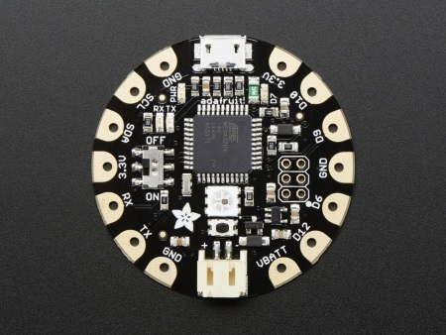
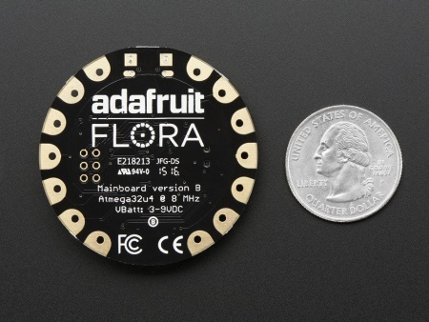
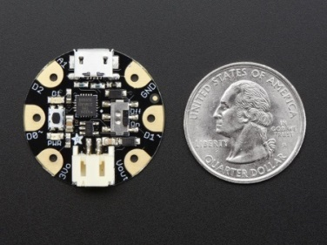
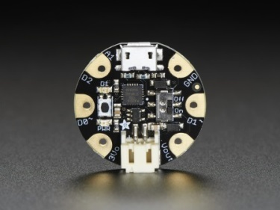
Adafruit Flora and Gemma
Smaller than Arduino and made for wearables!
1.8" round x 0.3" thick
Based on the ATmega32u4
30K of usable flash memory
Only 1.1" / 28mm round x 0.28" / 7mm thick
ATtiny85 on-board
8K of flash
When it comes to wearables, you have to look at the form factor in addition to functionality

Slide 19
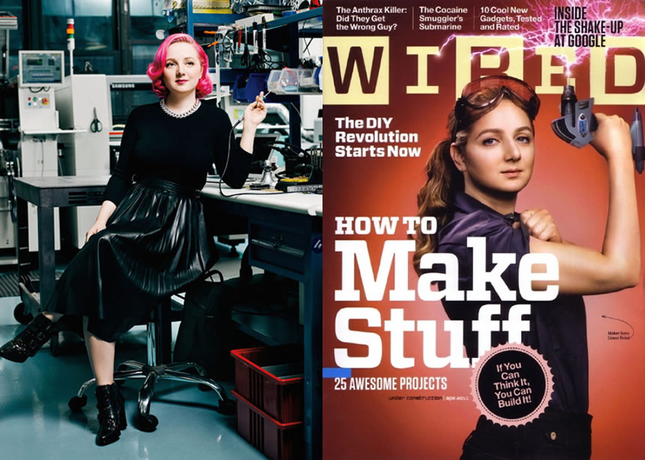
Adafruit and LadyAda
Adafruit was founded in 2005 by MIT hacker & engineer, Limor "Ladyada" Fried. Her goal was to create the best place online for learning electronics and making the best designed products for makers of all ages and skill levels. Adafruit has grown to over 100+ employees in the heart of NYC with a 50,000+ sq ft. factory. Adafruit has expanded offerings to include tools, equipment and electronics that Limor personally selects, tests and approves before going in to the Adafruit store. Limor was the first female engineer on the cover of WIRED magazine, awarded Entrepreneur magazine's Entrepreneur of the year, and was on the cover of Make: Vol. 57. Ladyada was a founding member of the NYC Industrial Business Advisory Council. Adafruit is ranked #11 in the top 20 USA manufacturing companies and #1 in New York City by Inc. 5000 "fastest growing private companies". Adafruit is featured in Google's Economic Impact Report. Limor was named a WHITEHOUSE CHAMPION OF CHANGE in 2016. Adafruit is a 100% woman owned company.

Slide 20
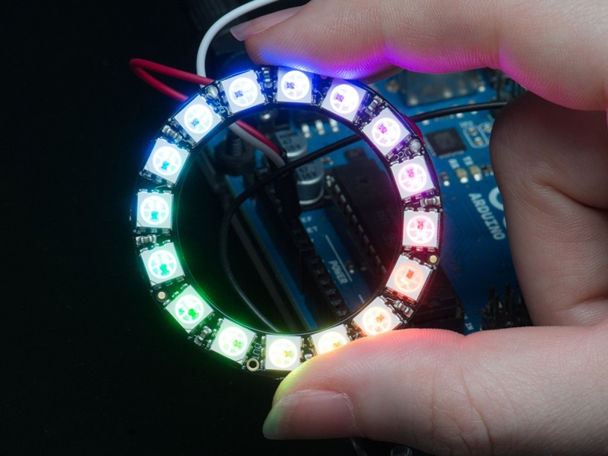
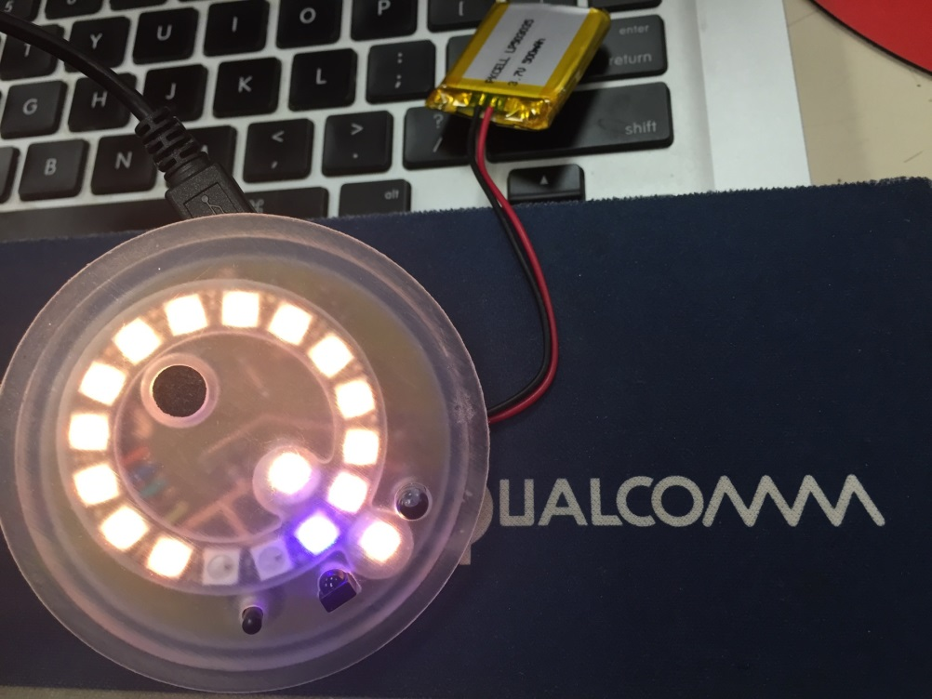
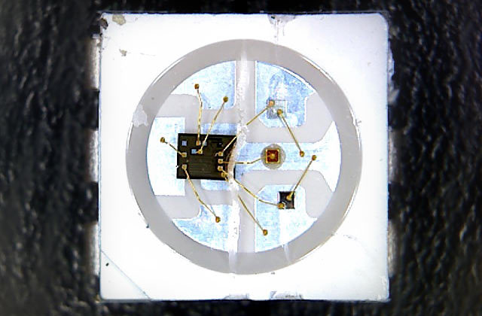
NeoPixels
More than your average LED
WS2812
Dedicated LED driver chip
Individually addressable
Use single-wire control protocol

Slide 21
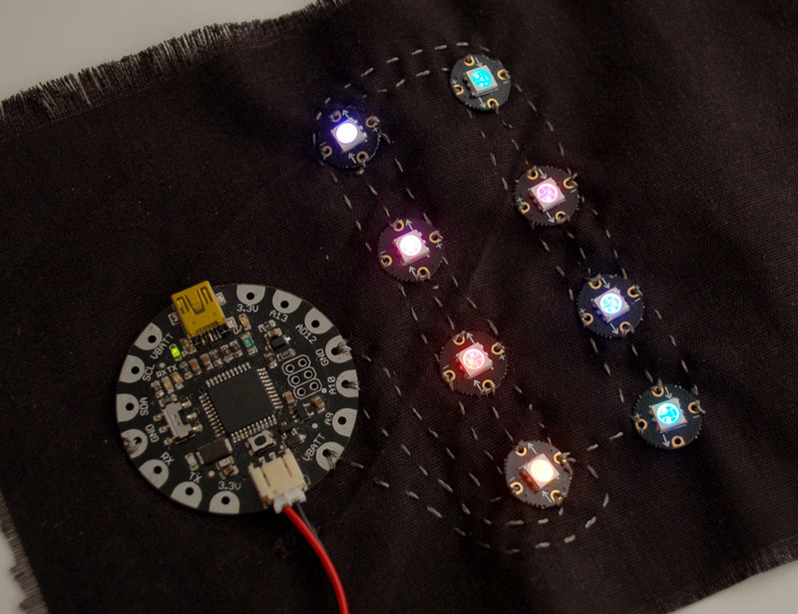
Flora/Gemma + NeoPixels
For your sweet rave parties. Or practical applications.
Ground
Power
Din
Dout

Slide 22
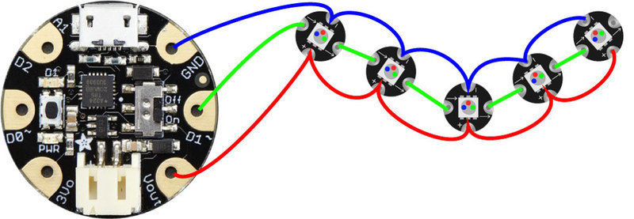
Gemma + NeoPixels
A closer look
GND, D1, Vout (5V)

Slide 23
Getting Started with Coding
IDE, libraries, example code, circuit layout
Install IDE, drivers, and NeoPixel library
Open File > Examples > Adafruit NeoPixels > simple/strandtest
Modify the code to work with your microcontroller
Output pin, number of pixels
Upload the code to your Gemma microcontroller

Slide 24
Controlling NeoPixels
Use the Adafruit NeoPixel Libraries!
All NeoPixel sketches begin by including the header file:
#include <Adafruit_NeoPixel.h>
The block of code that follows is mostly descriptive comments.
Only the last line is really doing any work:
#define PIN 6
// Parameter 1 = number of pixels in strip
// Parameter 2 = pin number (most are valid)
// Parameter 3 = pixel type flags, add together as needed:
// NEO_KHZ800 800 KHz bitstream (most NeoPixel products w/WS2812 LEDs)
// NEO_KHZ400 400 KHz (classic 'v1' (not v2) FLORA pixels, WS2811 drivers)
// NEO_GRB Pixels are wired for GRB bitstream (most NeoPixel products)
// NEO_RGB Pixels are wired for RGB bitstream (v1 FLORA pixels, not v2)
Adafruit_NeoPixel strip = Adafruit_NeoPixel(60, PIN, NEO_GRB + NEO_KHZ800);

Slide 25
Controlling the NeoPixels
Then, in the setup() function, call begin() to prepare the data pin for NeoPixel output:
void setup() {
strip.begin();
strip.show(); // Initialize all pixels to 'off'
}
To set the color of a pixel:
strip.setPixelColor(n, red, green, blue);
strip.show();
delay(500)

Slide 26
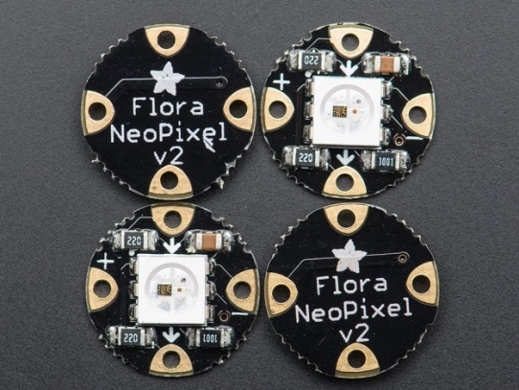
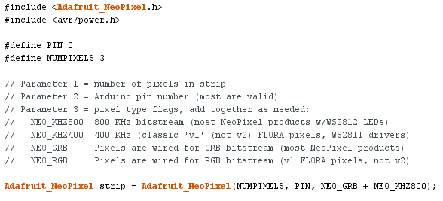
Wiring + Code
Which pin is Data?
Adjust code accordingly to which digital you use to drive the NeoPixels
Recommended starter program is simple.ino
Found under File > Examples > Neopixels
Adjust PIN (data pin), number of NeoPixels
GetSET Wearables Packet

Slide 27
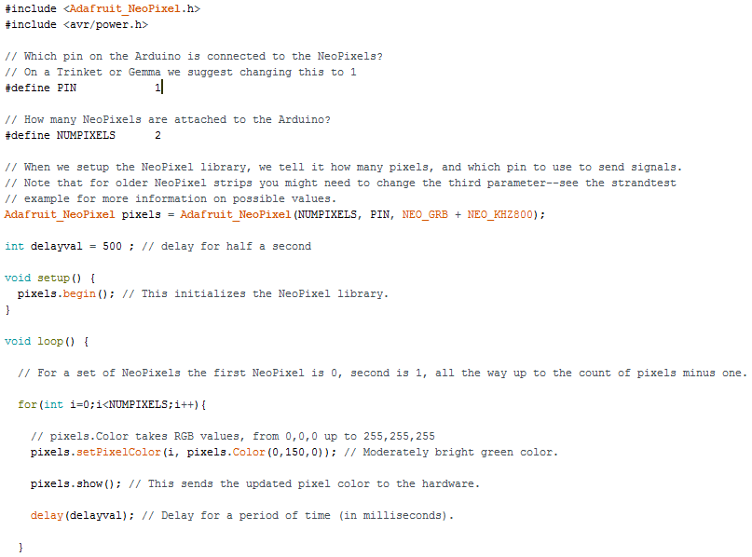
General Arduino code structure

Slide 28
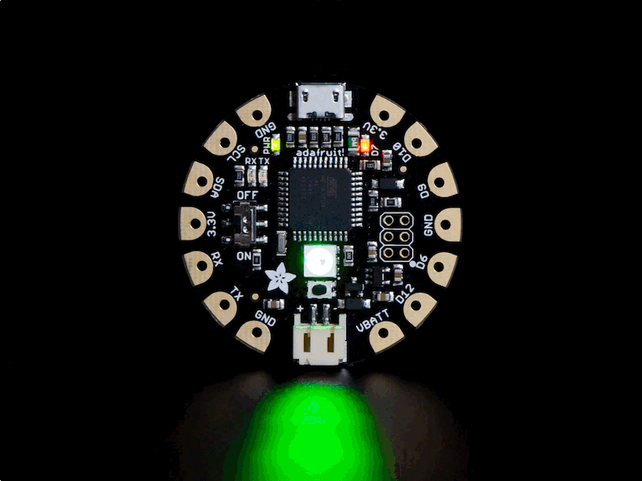
Adafruit Flora + Alligator Clips + NeoPixel
Modding simple.ino -> GetSET Wearables Packet
GetSET Wearables Packet

Slide 29
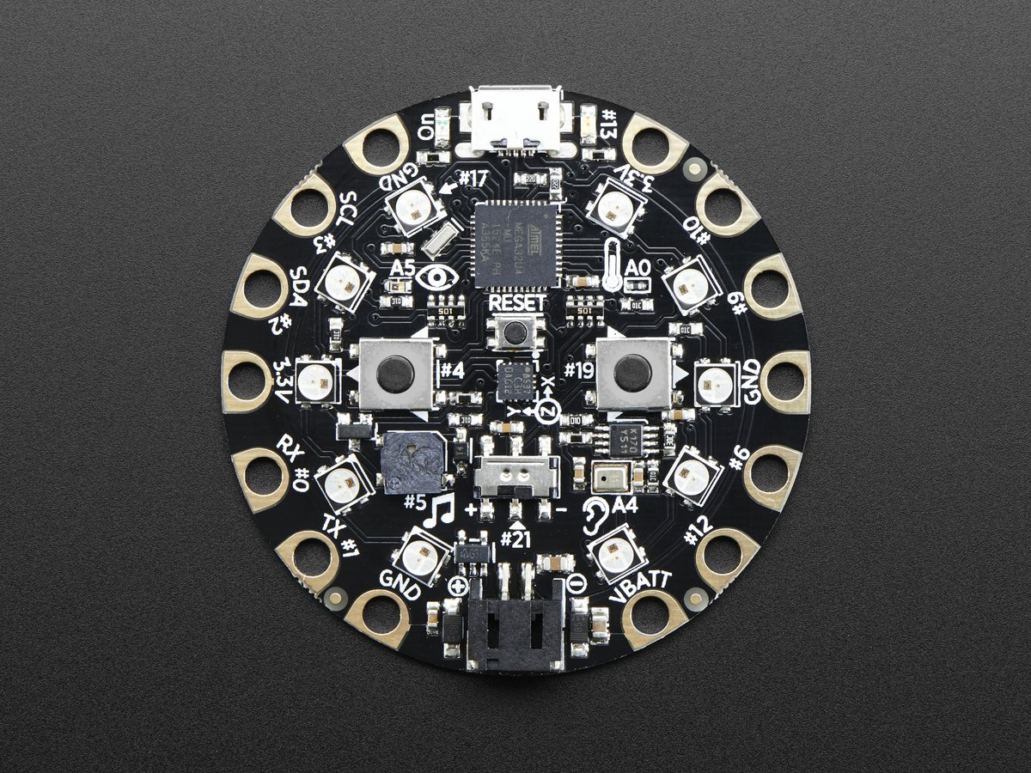
Adafruit Circuit Playground
Let’s put on our engineering hats! What’s different here?
How is it different from Flora?
Which sensors do we have on board?
Which sensor are we most interested in trying out?

Slide 30
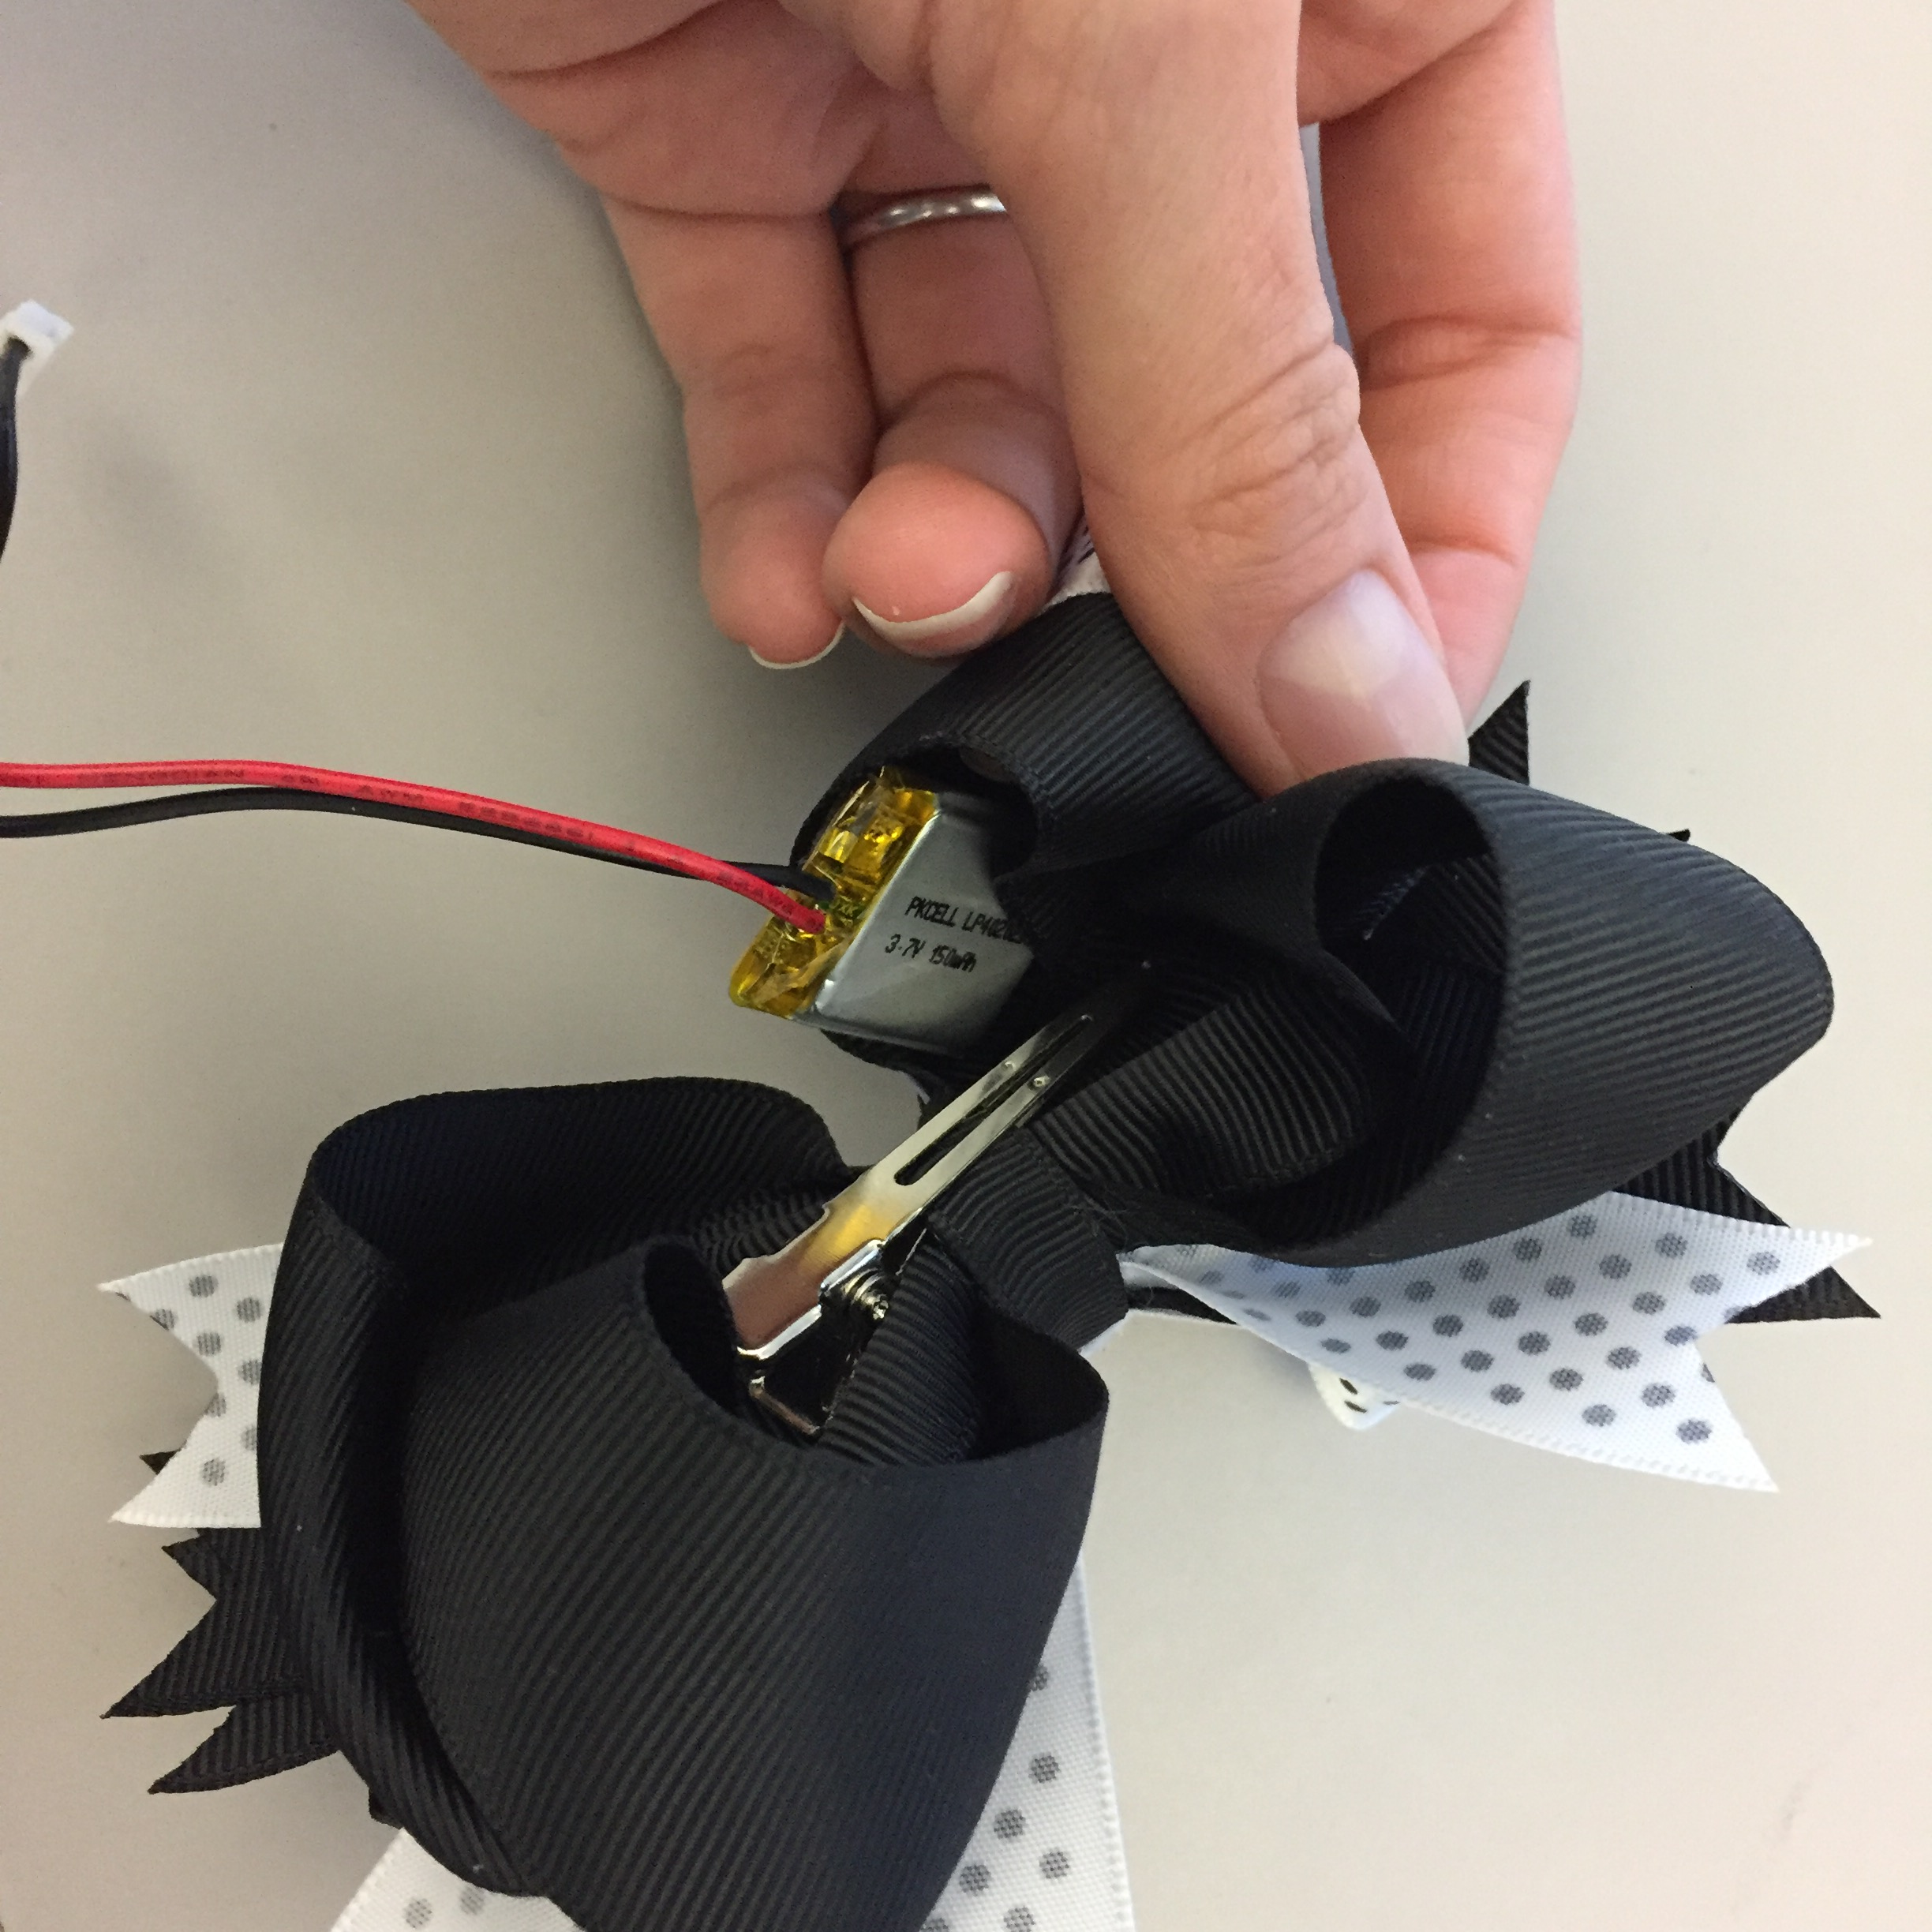
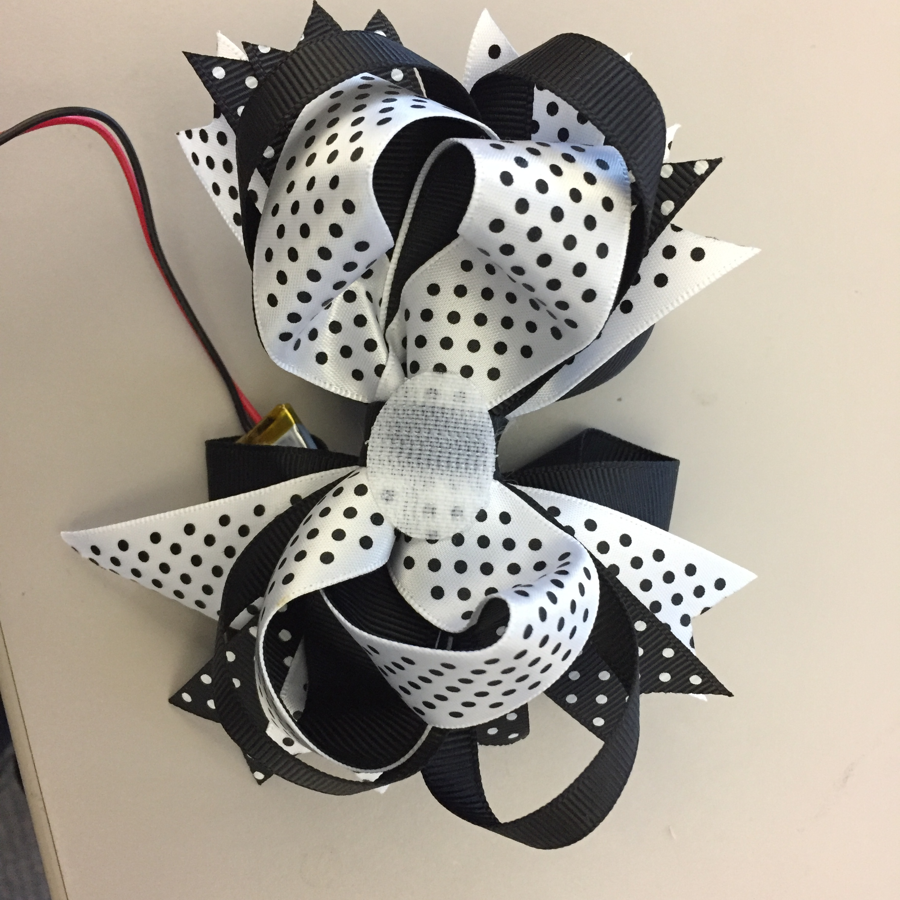
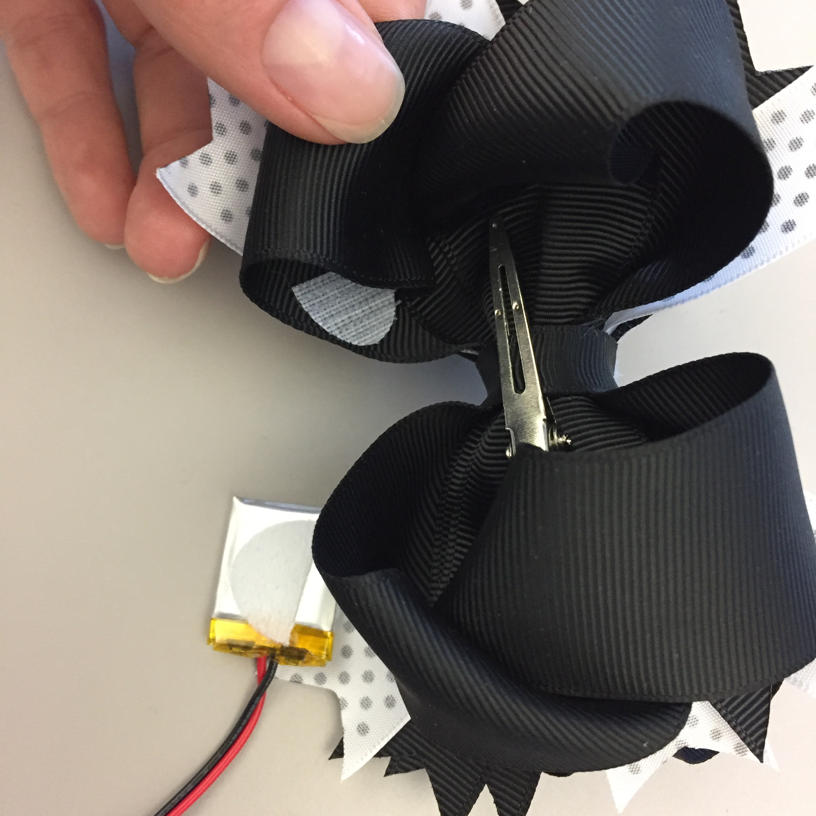
Adafruit Circuit Playground + Hair Bows
With a little help from Velcro…
Pick up your bow and assemble your wearable!

Slide 31
Fun with Adafruit Circuit Playground
Adjust the code from the Flora challenge and upload it to the Circuit Playground.
Activate all 10 NeoPixels on board - no alligator clips!
First, make them light Red, Green, and Blue in sequence, with an interval of 200 milliseconds between each NeoPixel.
Next, make all 10 NeoPixels flash Red for 500 milliseconds, followed by Green, and then Blue.
Show your TA.
Upload Examples -> Adafruit Circuit Playground -> analog_sensors.ino to the Adafruit Circuit Playground.
Adjust the code to activate all 10 NeoPixels. Change the MIN and MAX colors for 1 or more values of your choice (R,G,B)
Try our different sensors and show your TA.
Upload some other example programs, like:
Birthday_Candles.ino (whoever fixes the flat note first is my hero!)
mega_demo.ino
color_sense.ino
comm_badge.ino
…+ customize them!
Another fun demo: https://learn.adafruit.com/circuit-playground-hourglass/overview

Slide 32
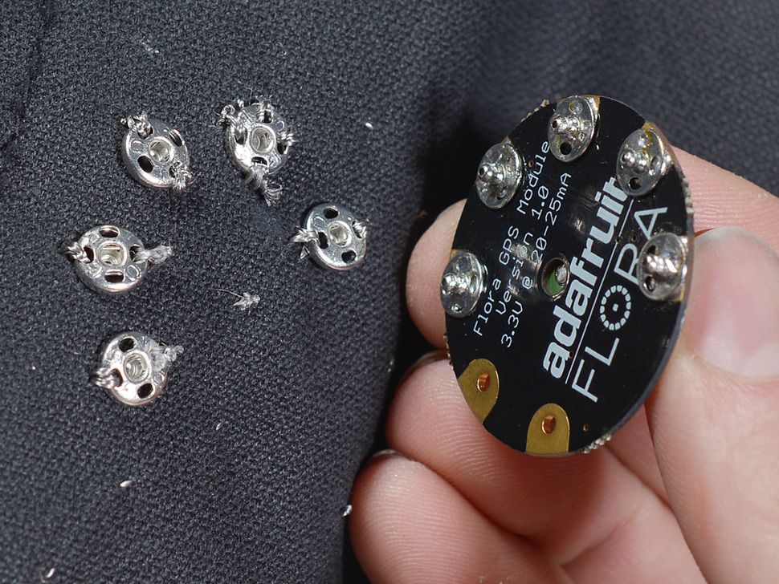
Microcontroller + Snaps
Make your Gemma reu$able!
Snap your Gemma in place instead of permanently sewing it in

Slide 33
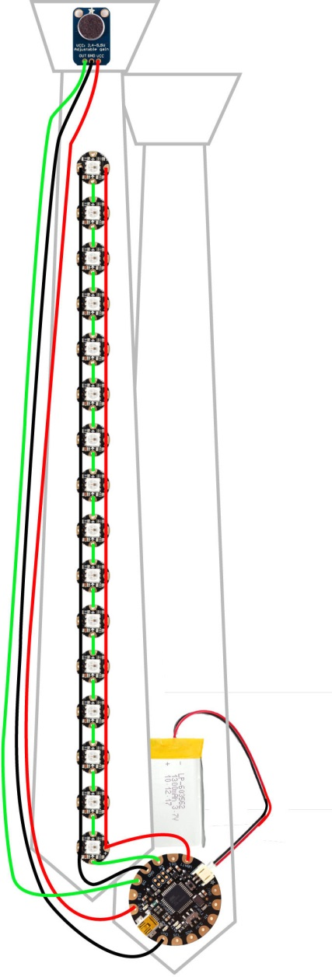

So, how do we make wearables?
Think about your circuit layout and the # of NeoPixels you’ll use
Will your wires be part of the design or stay behind the scenes?

Slide 34
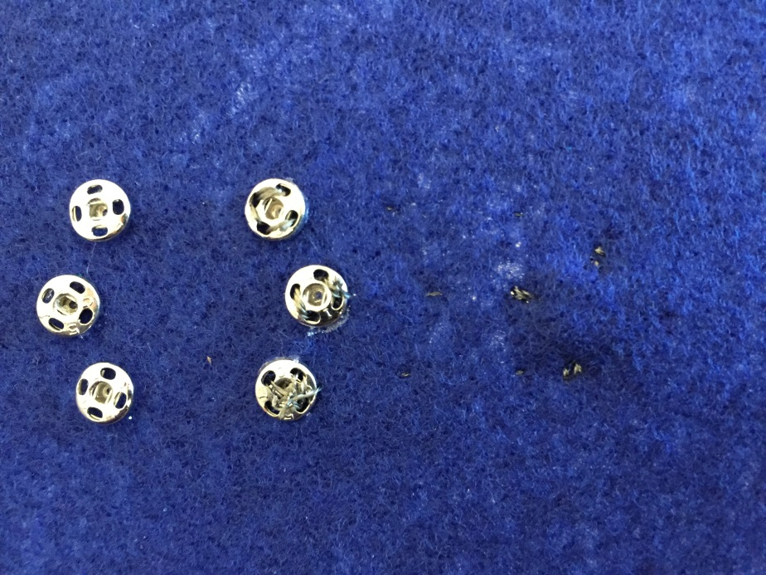
So, how do we do this?
Think about your circuit layout and the # of NeoPixels you’ll use
Will your wires be part of the design or stay behind the scenes?
Glue your Gemma in place
Wait 2 minutes for the glue to dry, then gently snap off the Gemma, one pin at a time

Slide 35
So, how do we do this?
Think about your circuit layout and the # of NeoPixels you’ll use
Will your wires be part of the design or stay behind the scenes?
Glue your Gemma in place
Wait 2 minutes for the glue to dry, then gently snap off the Gemma, one pin at a time
Draw your wires on the inside of the shirt or on your item
Use the air/water-soluble markers
Get your circuit approved
Start stitching!

Slide 36
Let’s put it all together!
Example: 1 Gemma + 3 Neopixels + IEEE Robot shirt

Slide 37
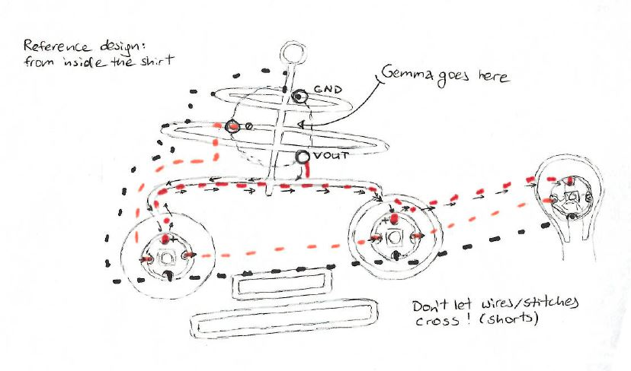
Let’s put it all together!
Example: 1 Gemma + 3 Neopixels + IEEE Robot shirt

Slide 38
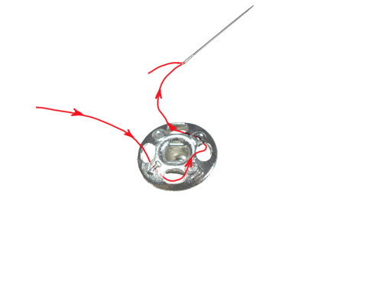
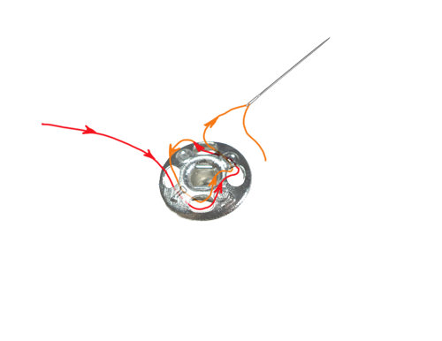
Stitching on snaps
After gently snapping off your Gemma
Leave about 2.5” of thread on this end for a knot at the beginning and the end with the long string
Tie these 2 ends together and snip off the short side of the thread that is not attached to a needle
Stitch through all 4 holes around the rim of the snap
Loop 1
Loop 2
IMPORTANT: Apply nail polish to tied off end of the thread
Continue stitching from the snap to the appropriate pin on the NeoPixel (Power, Ground, or Din)

Slide 39
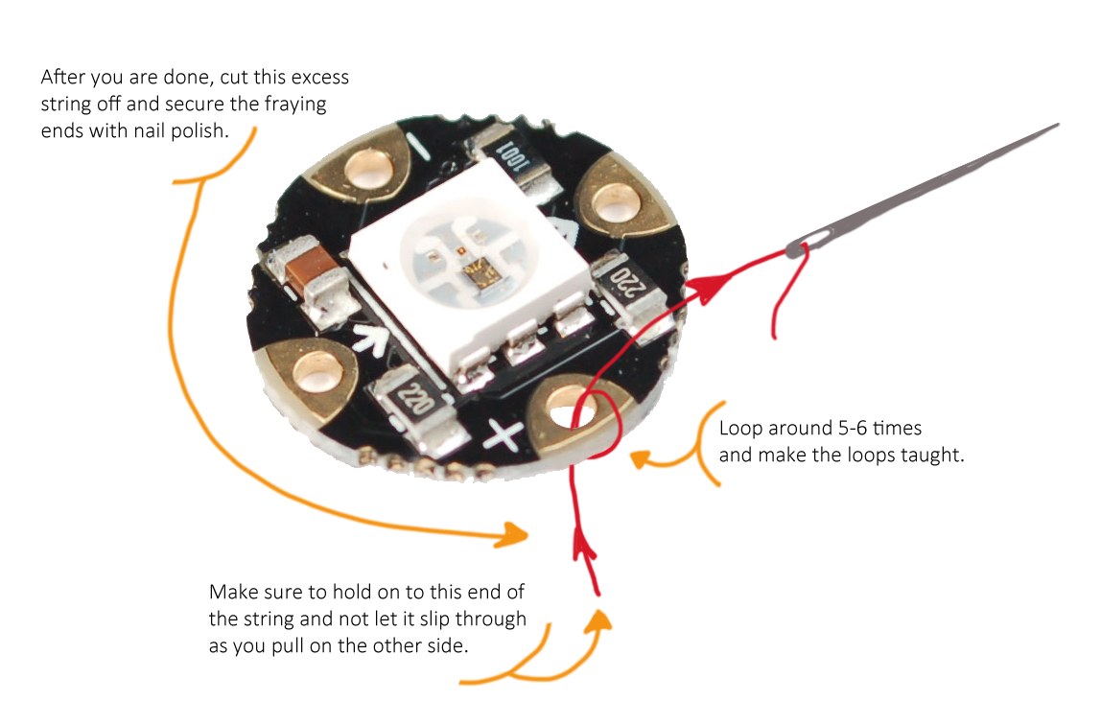
Sewing on NeoPixels
Tips and tricks

Slide 40
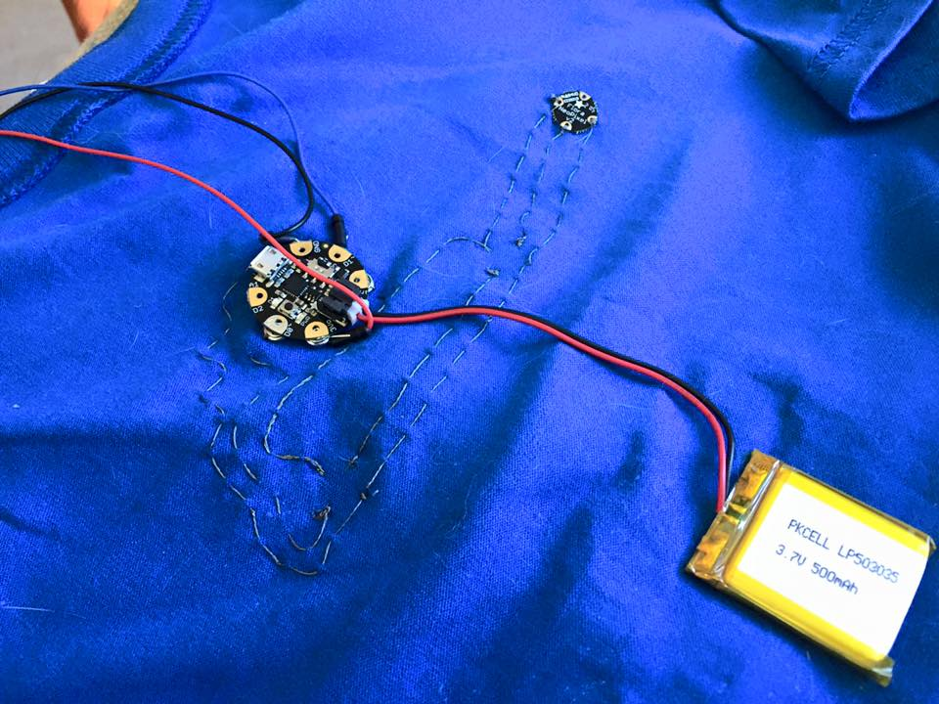
Getting the rave party going
Once your circuit is complete:
Plug in the battery
Velcro the battery to the shirt, below the circuit, or to any other convenient spot
Soft part of the Velcro goes on the shirt, spiky part on the battery
Turn on the Gemma! (there is a switch)

Slide 41
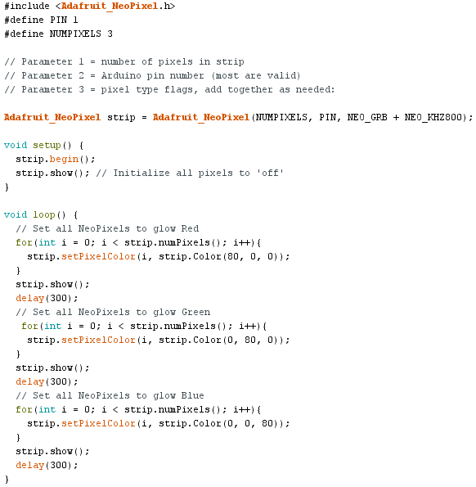
Wearables_3npx_lvl1.ino code

Slide 42
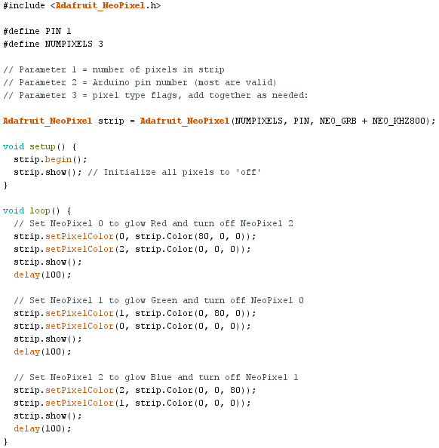
Wearables_3npx_lvl2.ino code

